Slide 1

Algorithms Design and Analysis- 2
Maximum Flow Problem
Mayada Hadhoud
Computer Engineering Department
Cairo University
Fall 2016

Slide 2
Iterative Improvement
Algorithm design technique for solving optimization problems
Start with a feasible solution
Repeat the following step until no improvement can be found:
change the current feasible solution to a feasible solution with a better value of the objective function
Return the last feasible solution as optimal
Note: Typically, a change in a current solution is “small” (local search)
Major difficulty: Local optimum vs. global optimum

Slide 3
Network Flow Problem
A type of network optimization problems
Arise in many different contests
Networks: routing as many packets as possible on a given network .
Transportation: sending as many trucks as possible, where roads have limits on the number of trucks per unit time.

Slide 4
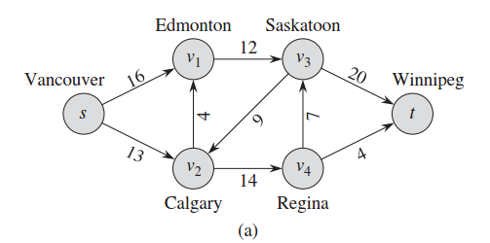
Flow Networks
A flow network G=(V,E): a directed graph, where each edge (u,v)∈E has a nonnegative capacity c(u,v)>=0.
If (u,v)∉E, we assume that c(u,v)=0.
two distinct vertices :a source s and a sink t.

Slide 5
Flow Networks
A flow in G: a real-valued function f satisfying the following two properties:
Capacity constraint: For all u,v ∈V,
we require f(u,v) ≤ c( u,v).
Flow conservation: For all u ∈V-{s,t}, we require

Slide 6
Net flow and value of a flow f
The quantity f (u,v) is called the net flow from vertex u to vertex v.
The value of a flow is defined as
The total flow from source to any other vertices.
The same as the total flow from any vertices to the sink.

Slide 7
Lucky Puck Distribution Network

Slide 8
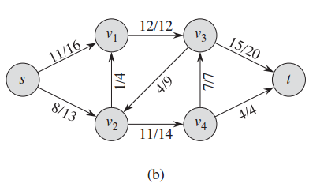
Max Flow, |f| = 19
is it Best we can do?

Slide 9
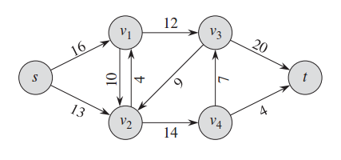
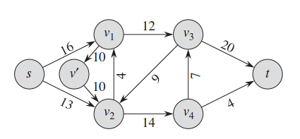
Modeling Problems with Antiparallel Edges

Slide 10
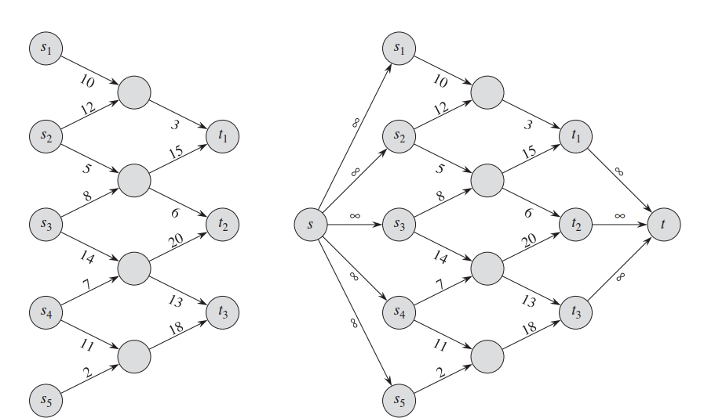
Modeling Networks with Multiple Sources and Sinks
SuperSource
SuperSink

Slide 11
Maximum-flow problem
Given a flow network G with source s and sink t
Find a flow of maximum value from s to t.
How to solve it efficiently?

Slide 12
The Ford-Fulkerson method
It is a “method” for solving Max Flow problem
It called a “method” rather than an “algorithm” because it has several implementations with different running times.
The Ford-Fulkerson method depends on three important ideas : residual networks, augmenting paths, and cuts.
These ideas are essential to the important max-flow min-cut theorem, which characterizes the value of maximum flow in terms of cuts of the flow network.

Slide 13
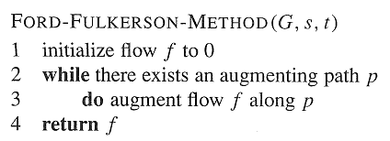
The Ford-Fulkerson method

Slide 14
Residual Networks
Given a flow network and a flow, the residual network consists of edges that can admit more net flow.
G=(V,E) : a flow network with source s and sink t
f: a flow in G.
The amount of additional net flow from u to v before exceeding the capacity c(u,v) is the residual capacity of (u,v),
c_{f}(u,v)=c(u,v)-f(u,v)

Slide 15
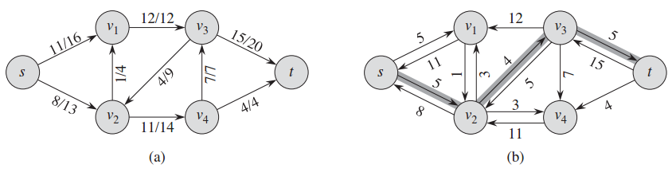
Example of residual network

Slide 16
Residual Networks
Let G=(V,E) be a flow network with source s and sink t, and let f be a flow in G.
Let G_{f} be the residual network of G induced by f,and let f’ be a flow in G_{f}.
Then, the flow sum f+f’ is a flow in G with value
f+f’:
the flow in the same direction will be added.
the flow in different directions will be cancelled.

Slide 17
Augmenting paths
Given a flow network G=(V,E) and a flow f, an augmenting path is a simple path from s to t in the residual network G_{f}.
Residual capacity of p : the maximum amount of net flow that we can ship along the edges of an augmenting path p, i.e., c_{f}(p)=min{c_{f}(u,v):(u,v) is on p}.
2
3
1
The residual capacity is 1.

Slide 18
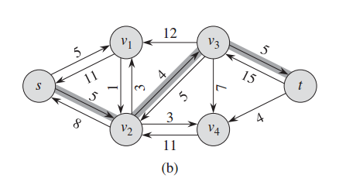
Example of an augment path (bold edges)

Slide 19
The basic Ford-Fulkerson algorithm
FORD-FULKERSON(G,s,t)
for each edge (u,v) ∈E[G]
do f[u,v] 0
f[v,u] 0
while there exists a path p from s to t in the residual network G_{f}
do c_{f}(p) min{c_{f}(u,v): (u,v) is in p}
for each edge (u,v) in p
do f[u,v] f[u,v]+c_{f}(p)
The algorithms based on this method differ in how they choose p in step 3.
If chosen poorly the algorithm might not terminate.

Slide 20
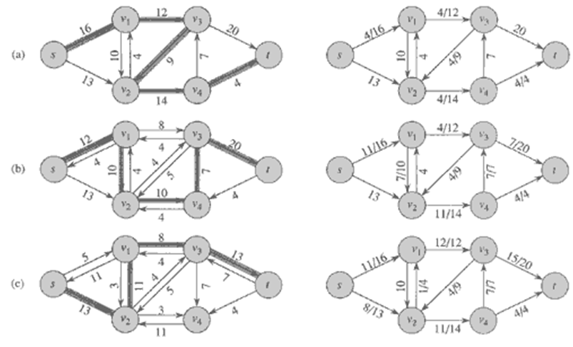
Execution of Ford-Fulkerson
Left Side = Residual Graph Right Side = Augmented Flow

Slide 21
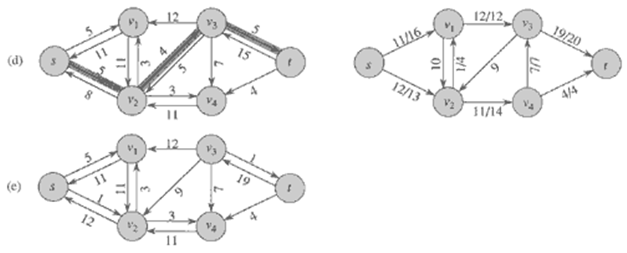
Execution of Ford-Fulkerson
Left Side = Residual Graph Right Side = Augmented Flow

Slide 22
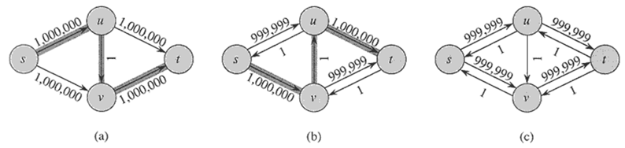
Worst Case Running Time
Assuming integer flow
Each augmentation increases the value of the flow by some positive amount.
Augmentation can be done in O(E).
Total worst-case running time O(E|f*|), where f* is the max-flow found by the algorithm.
Example of worst case:
Augmenting path of 1
Resulting Residual Network
Resulting Residual Network

Slide 23
Edmonds Karp
Take shortest path (in terms of number of edges) as an augmenting path – Edmonds-Karp algorithm
How do we find such a shortest path?
Running time O(VE²), because the number of augmentations is O(VE)
Even better method: push-relabel, O(V²E) runtime

Slide 24
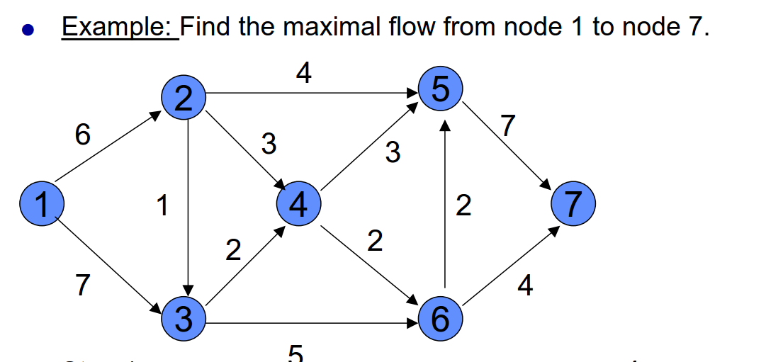

Slide 25
Assignment
Maximum bipartite matching

